Slide 1

INTRODUCTION TO DEEP LEARNING
PRESIDENCY UNIVERSITY, BENGALURU
SCHOOL OF ENGINEERING
Prof. Tapas Guha
Presidency University, Bangalore

Slide 2
Roadmap
Introduction to Deep Learning
Neural Networks
How do Neural Networks work?
How do Neural Networks learn?
Back Propagation Algorithm
Gradient Descent
Stochastic Gradient Descent

Slide 3
Introduction to Deep Learning
Artificial intelligence can be loosely interpreted to mean incorporating human intelligence to machines.
Whenever a machine completes tasks based on a set of stipulated rules that solve problems (algorithms), such an “intelligent” behavior is what is called artificial intelligence.
For example, such machines can move and manipulate objects, recognize whether someone has raised the hands, or solve other problems

Slide 4
Machine learning can be loosely interpreted to mean empowering computer systems with the ability to “learn”.
The intention of ML is to enable machines to learn by themselves using the provided data and make accurate predictions.
ML is a subset of artificial intelligence; in fact, it’s simply a technique for realizing AI.
It is a method of training algorithms such that they can learn how to make decisions.
Training in machine learning entails giving a lot of data to the algorithm and allowing it to learn more about the processed information.

Slide 5
Deep learning is a subfield of ML, concerned with algorithms inspired by the structure and function of Brain called Artificial Neural Networks
In other words, DL is the next evolution of machine learning.
DL algorithms are roughly inspired by the information processing patterns found in the human brain.
Just like we use our brains to identify patterns and classify various types of information, deep learning algorithms can be taught to accomplish the same tasks for machines.
Whenever we receive a new information, the brain tries to compare it to a known item before making sense of it — which is the same concept deep learning algorithms employ.
For example, artificial neural networks (ANNs) are a type of algorithms that aim to imitate the way our brains make decisions.

Slide 6
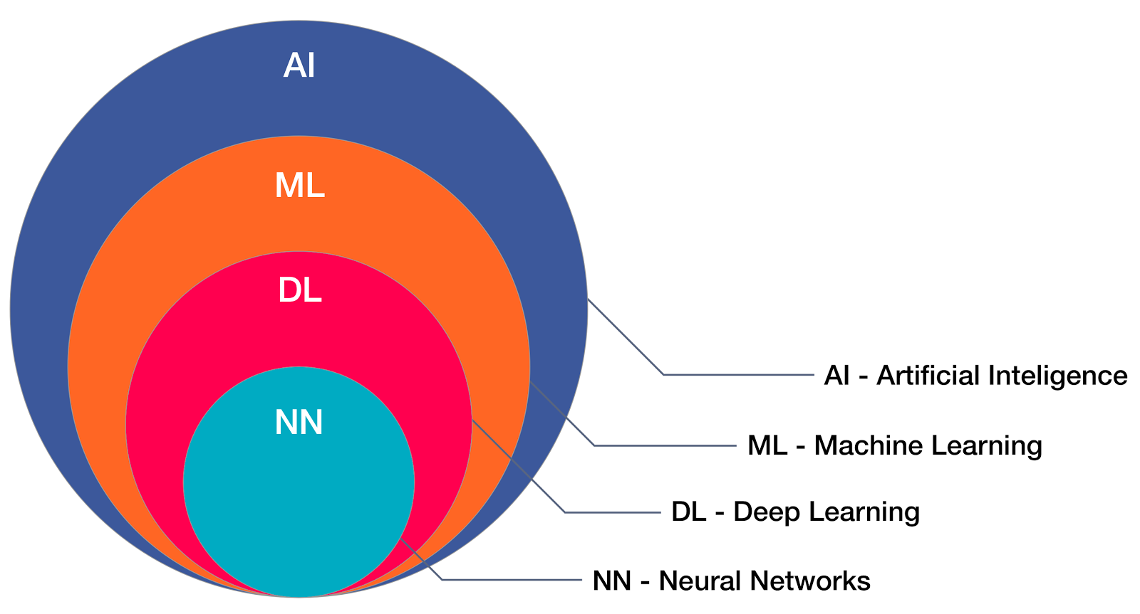
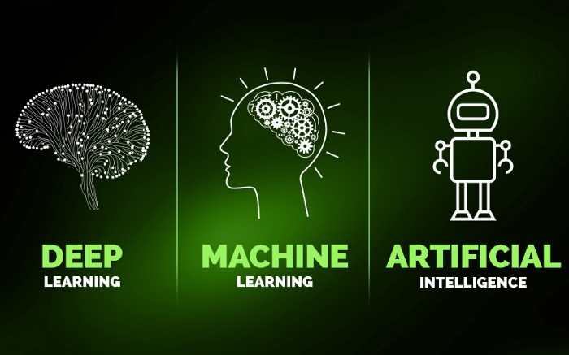
A Neural Network is a biological representation of neurons in the brain it deals with all the connections and chemical reactions in the brain and tries to imitate the same type of operations. Artificial Neural Networks are the computational models inspired by the human brain.

Slide 7
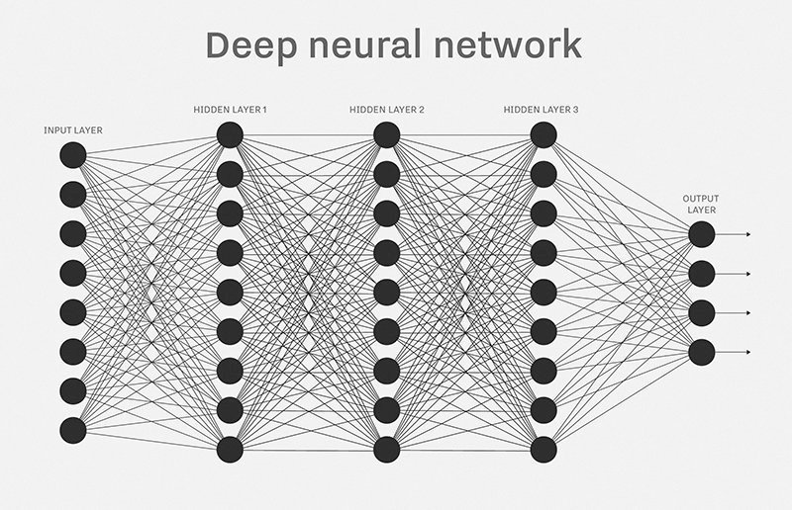
More about Neural Networks:
Neural Networks is one of the most popular machine learning algorithms at present. It has been decisively proven over time that neural networks outperform other algorithms in accuracy and speed.
With various variants like CNN (Convolutional Neural Networks), RNN(Recurrent Neural Networks), AutoEncoders, Deep Learning etc
A neural network having more than one hidden layer is Deep Neural Network.

Slide 8
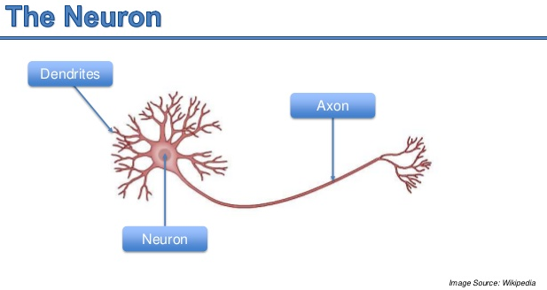
Neural networks were inspired by the neural architecture of a human brain, and like in a human brain the basic building block is called a Neuron. Its functionality is similar to a human neuron, i.e. it takes in some inputs and fires an output.

Slide 9
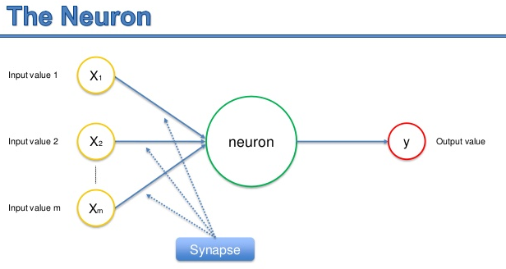

Slide 10
The function used in a neuron is generally termed as an activation function
There are 3 major activation functions
Sigmoid
TanH
ReLU
Sigmoid Activation function: It is a activation function of form
f(x) = 1 / 1 + exp(-x). Its Range is between 0 and 1.
Hyperbolic Tangent function- Tanh : It’s mathamatical formula is f(x) = 1 — exp(-2x) / 1 + exp(-2x). Now it’s output is zero centered because its range in between -1 to 1 i.e -1 < output < 1
ReLu- Rectified Linear units: R(x) = max(0,x) i.e if x < 0 , R(x) = 0 and if x >= 0 , R(x) = x. Hence as seeing the mathamatical form of this function we can see that it is very simple and efficinent

Slide 11
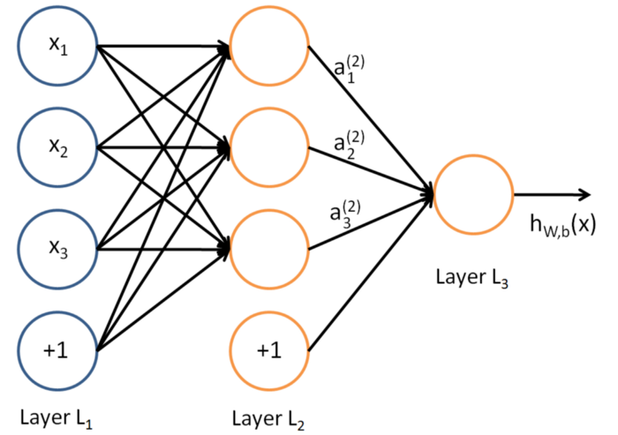
What is a layer in a Neural Network?
A layer is nothing but a collection of neurons which take in an input and provide an output. Inputs to each of these neurons are processed through the activation functions assigned to the neurons.

Slide 12
Properties of Neural Networks
The leftmost layer of the network is called the input layer, and the rightmost layer the output layer
The middle layer of nodes is called the hidden layer because its values are not observed in the training set.
Any neural network has 1 input and 1 output layer and number of hidden layers. The number of hidden layers, for instance, differ between different networks depending upon the complexity of the problem to be solved.
Each of the hidden layers can have a different activation function, for instance, hidden layer1 may use a sigmoid function and hidden layer2 may use a ReLU, followed by a Tanh in hidden layer3 all in the same neural network.
For a neural network to make accurate predictions each of these neurons learn certain weights at every layer. The algorithm through which they learn the weights is called back propagation.

Slide 13
Weights(Parameters) — A weight represent the strength of the connection between units. If the weight from node 1 to node 2 has greater magnitude, it means that neuron 1 has greater influence over neuron 2.
A weight brings down the importance of the input value. Weights near zero means changing this input will not change the output. Negative weights mean increasing this input will decrease the output. A weight decides how much influence the input will have on the output.
Bias(Offset) — It is an extra input to neurons and it is always 1, and has it’s own connection weight. This makes sure that even when all the inputs are none (all 0’s) there’s going to be at least one activation in the neuron, which is this (the biased) one.

Slide 14
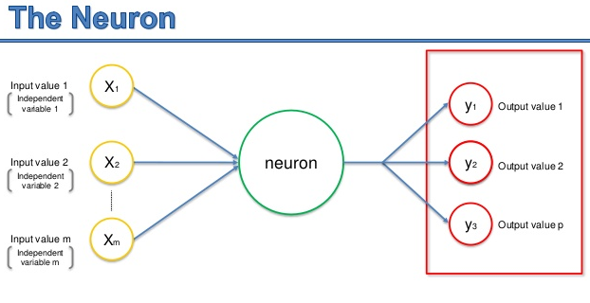

Slide 15
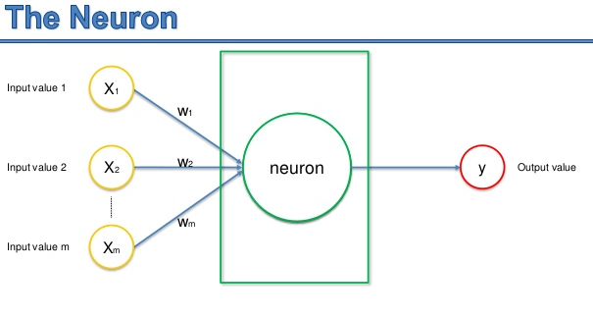

Slide 16
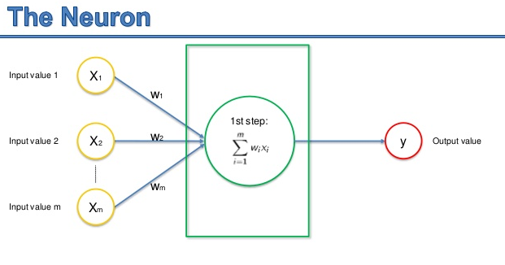

Slide 17
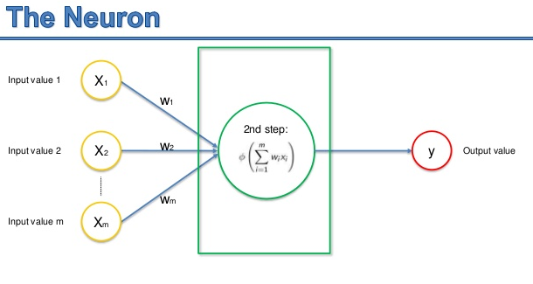

Slide 18
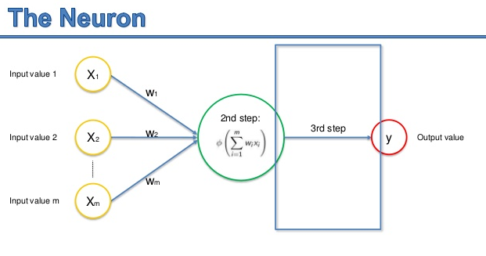

Slide 19


Slide 20
Activation Functions:
The function used in a neuron is generally termed as an activation function
There are 3 major activation functions
Sigmoid
TanH
ReLU
Sigmoid Activation function: It is a activation function of form
f(x) = 1 / 1 + exp(-x). Its Range is between 0 and 1.
Hyperbolic Tangent function- Tanh : It’s mathamatical formula is f(x) = 1 — exp(-2x) / 1 + exp(-2x). Now it’s output is zero centered because its range in between -1 to 1 i.e -1 < output < 1
ReLu- Rectified Linear units: R(x) = max(0,x) i.e if x < 0 , R(x) = 0 and if x >= 0 , R(x) = x. Hence as seeing the mathamatical form of this function we can see that it is very simple and efficinent

Slide 21
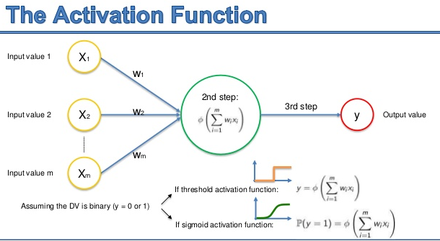

Slide 22
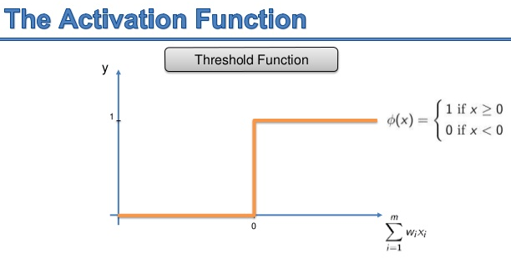

Slide 23
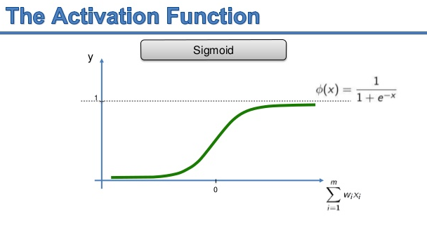

Slide 24
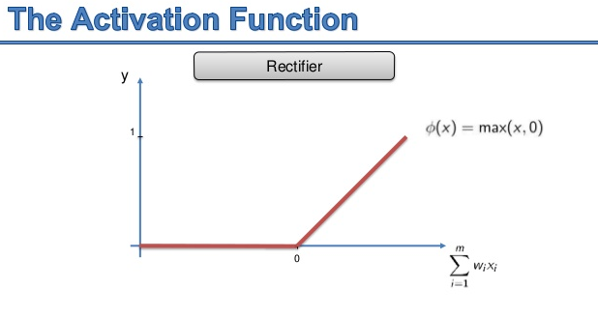

Slide 25
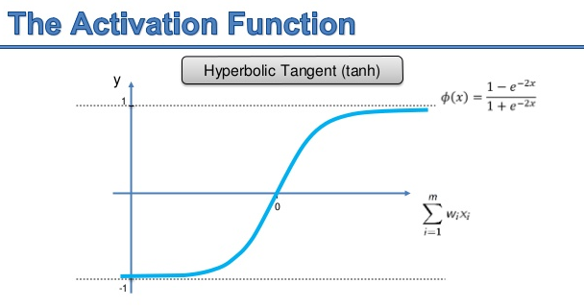

Slide 26
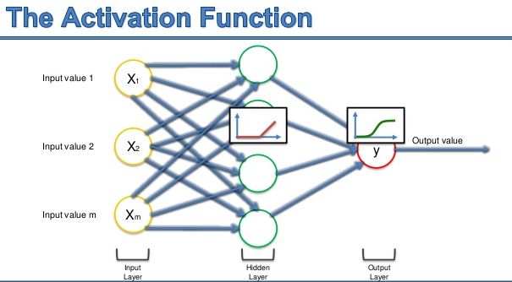

Slide 27
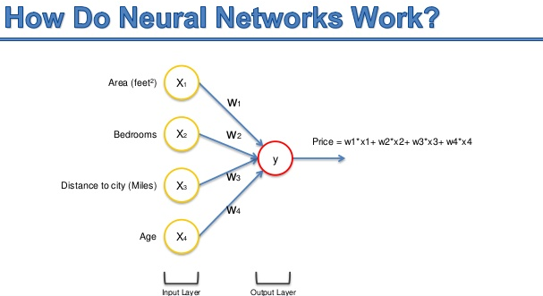

Slide 28
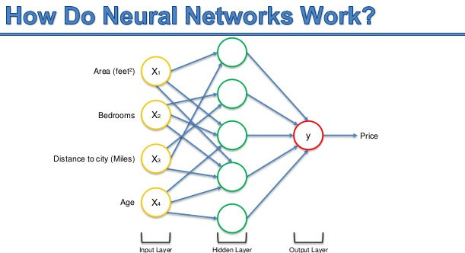

Slide 29
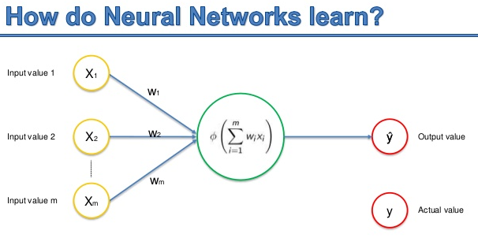

Slide 30
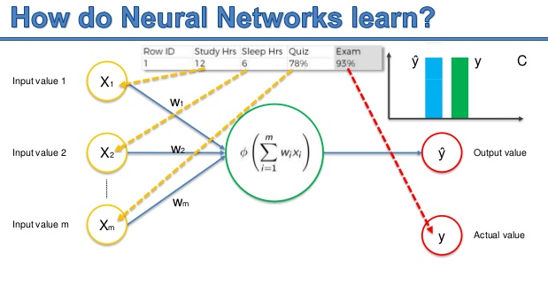

Slide 31
BACK - PROPAGATION

Slide 32
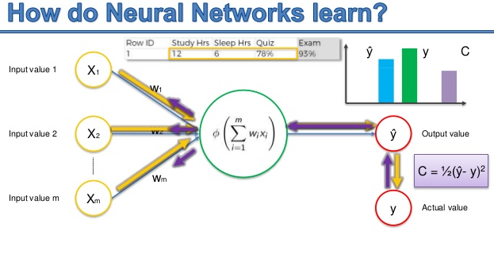
C = Loss = Mean Squared Error()

Slide 33
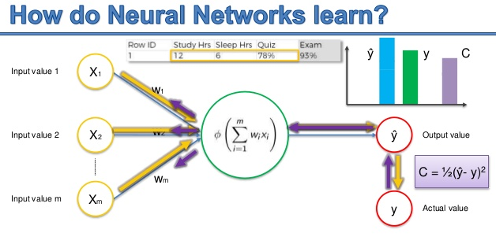

Slide 34
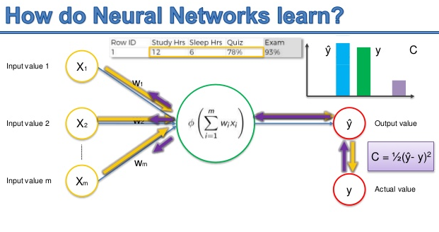

Slide 35
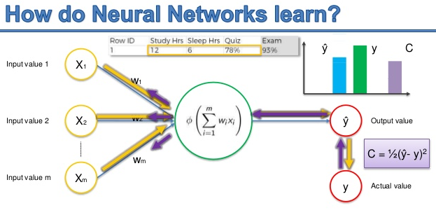

Slide 36
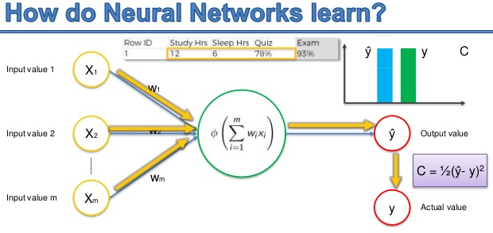

Slide 37
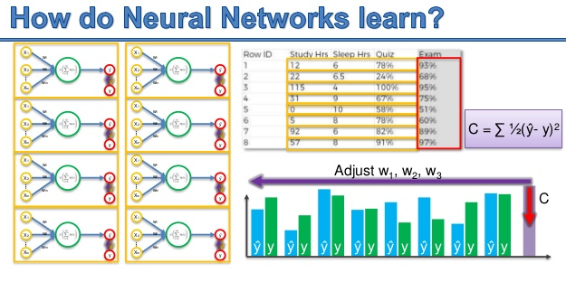

Slide 38
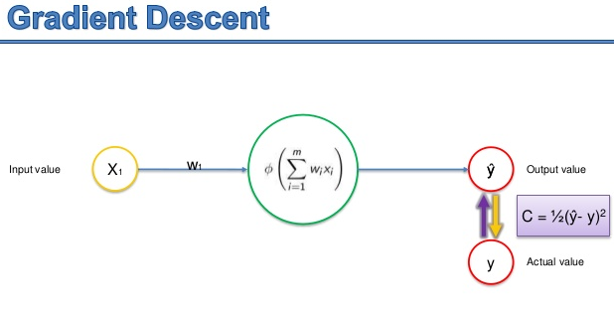

Slide 39
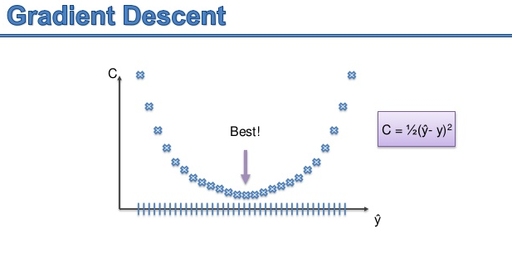

Slide 40
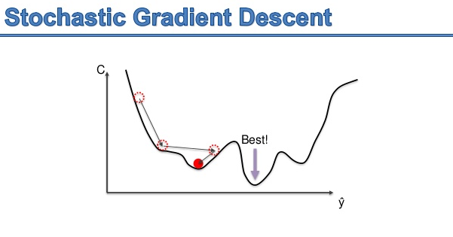

Slide 41
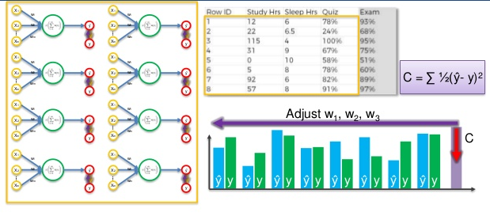
Batch Gradient Descent

Slide 42
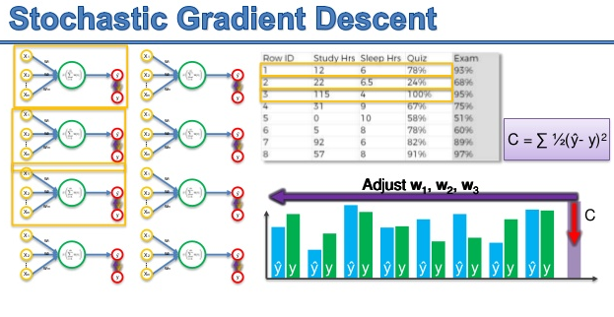

Slide 43
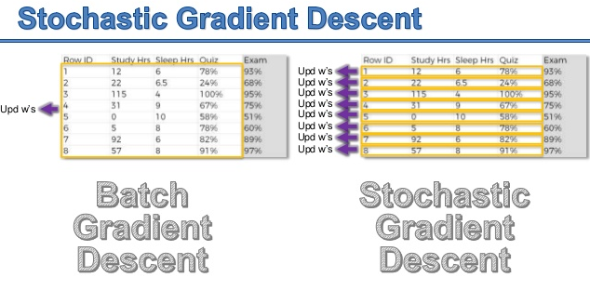

Slide 44
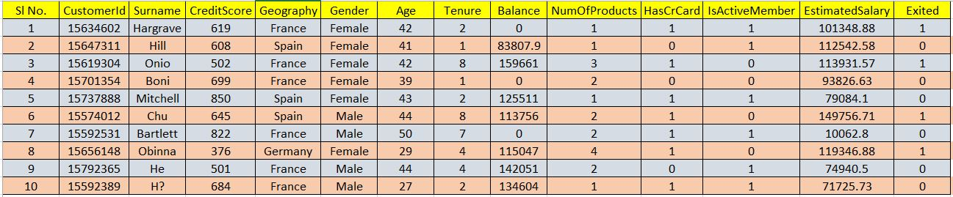
Hands-On Example - Dataset

Slide 45

Confusion Matrix

Slide 46
Thank you

